Slide 1

https://demowebshop.tricentis.com/
Capstone Project
Title :Demo Web Shop -Tricentis

Slide 2

Automation Testing for Demo Webshop
Introduction:
The Automation Testing Capstone Project focused on the website marked as significant milestone in the participants' learning journey. The project provided an opportunity to apply knowledge and skills acquired during the automation testing training, incorporating Selenium, TestNG, Cucumber, Apache POI, a hybrid framework, and advanced reporting tools like Allure/Extent. The objective is to create a comprehensive automation testing solution, fostering practical experience and showcasing participants' abilities to potential employers.
Modern PowerPoint Presentation

Slide 3
PROBLEM-STATEMENT
ModDemo Web Shop Tricentis is an online shopping platform where users can explore and purchase a wide range of products, including electronics, apparel, and books. Users can navigate through various categories, view detailed product information, add products to their cart, and proceed with order placement. Automating these key workflows is crucial to validate the platform's efficiency, accuracy, and reliability during the testing process, ensuring a seamless and error-free user experience.
ern PowerPoint Presentation

Slide 4
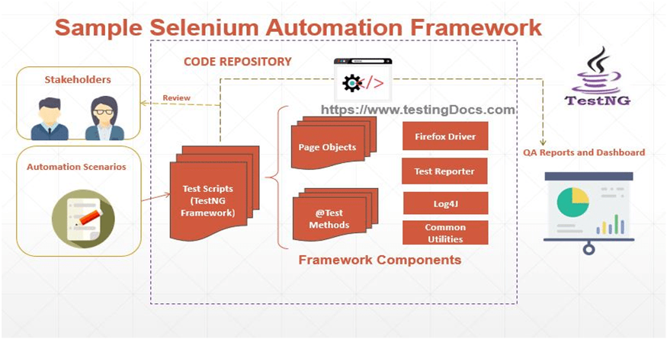
OUR JOURNEY WITH AUTOMATION:
Page Object Model (POM) for maintainability.
Cucumber BDD Framework
TestNG for test execution and reporting.
Selenium WebDriver for browser automation.
Extent Reports for test reporting.
Maven for dependency management.
Java
Git/Github

Slide 5
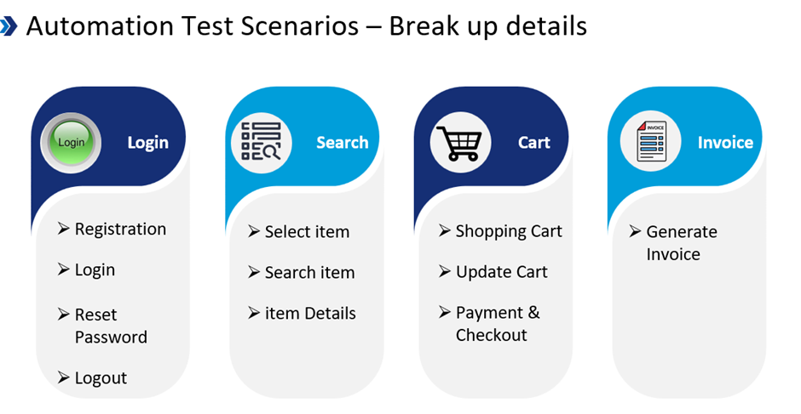
Objective: The objective of this project is to automate the user workflows of the Demoblaze online shopping platform using Selenium,TestNG,Page Object Model and Page Factory and BDD Cucumber.This includes automating tasks such as viewing product details,adding products to the cart,placing orders.The aim is to enhance the robustness of the testing process,reduce manual effort,and ensure a seamless user experience.
Test Flow:
Scenario 1: Registration
Scenario 2: Login
Scenario 3: Add to Cart
Scenario 4: Applying Discount Coupons
Scenario 5: Removing from Cart
Scenario 6: Confirm order
Scenario 7: Checkout

Slide 6
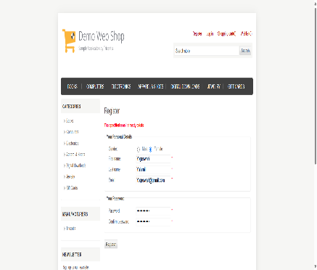
Scenario 1: Registration for Demo-Webshop website with valid and invalid credentials using TestNg framework using and generating Allure Reports and Extent Reports.
OutPuts:
Modern PowerPoint Presentation

Slide 7
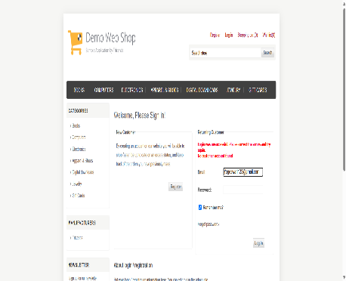
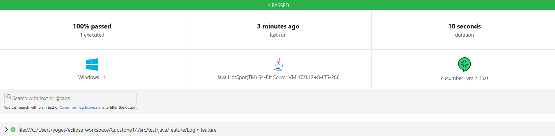
Scenario 2: Designed TestNg and Cucumber Framework for valid and Invalid Login credentials using POM, Data Properties ,Hooks and tags and generated Extent Reports and html reports
OUTPUT:

Slide 8
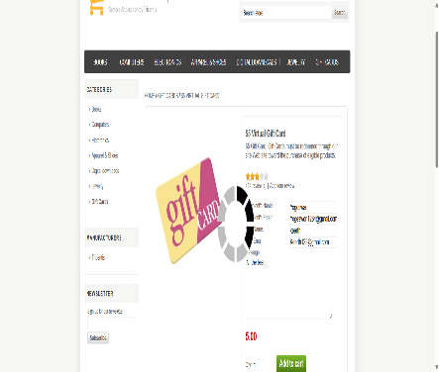
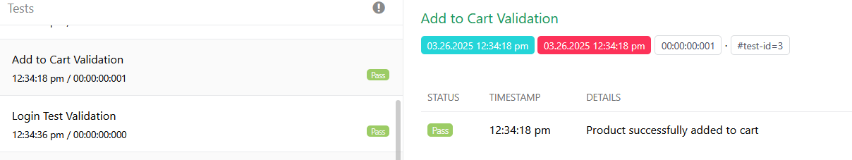
Scenario 3: Add to Cart using TestNg Framework, POM and generated ExtentReports
OUTPUT:

Slide 9
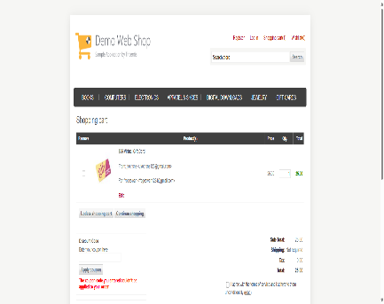
Scenario 4: Applying invalid discount Coupons to the Products using TestNG, POM generate allure reports and screenshots
OUTPUT:

Slide 10
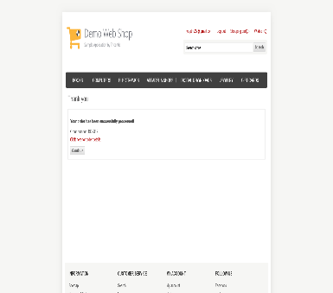
Scenario 5: Proceeding with the order confirmation using TestNG, POM generate allure reports and screenshots
OUTPUT:

Slide 11
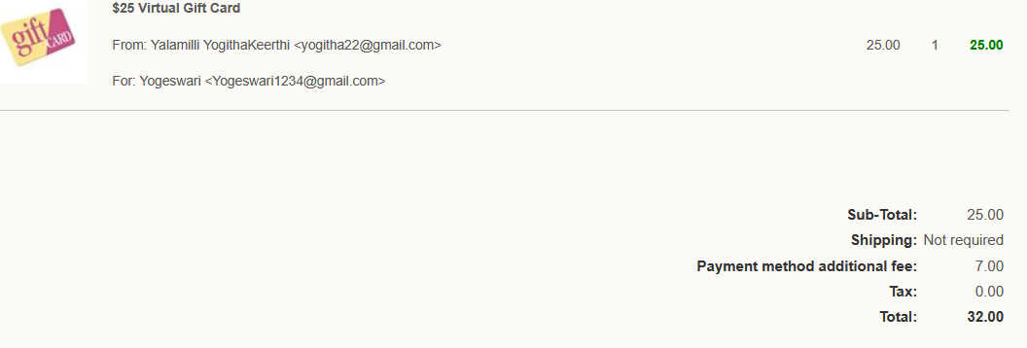
Scenario 6: Proceed to Checkout Using TestNG and generating allure reports.
OUTPUT:

Slide 12
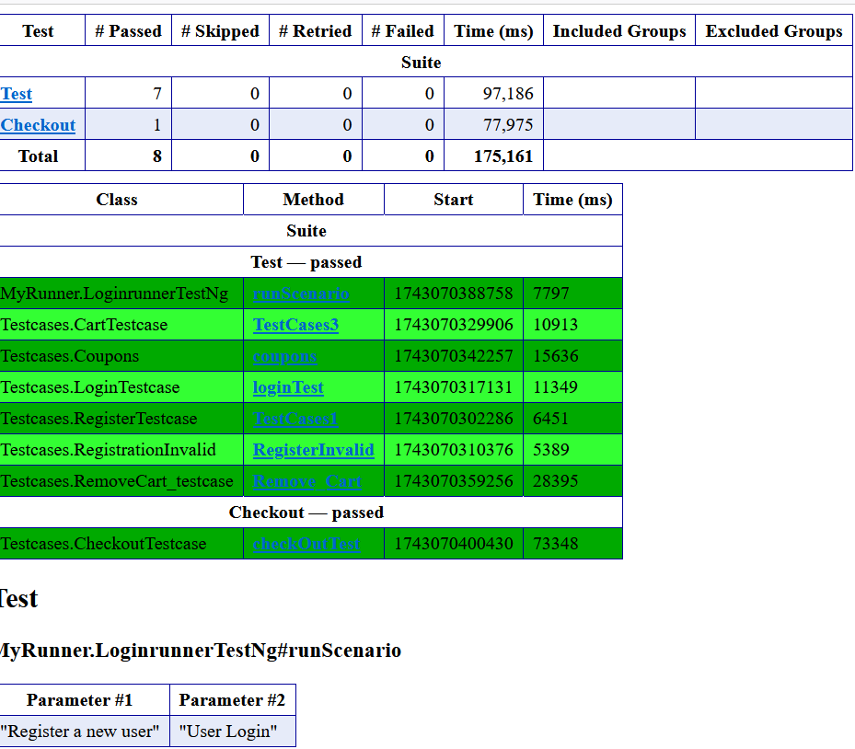
TestNG Report:

Slide 13
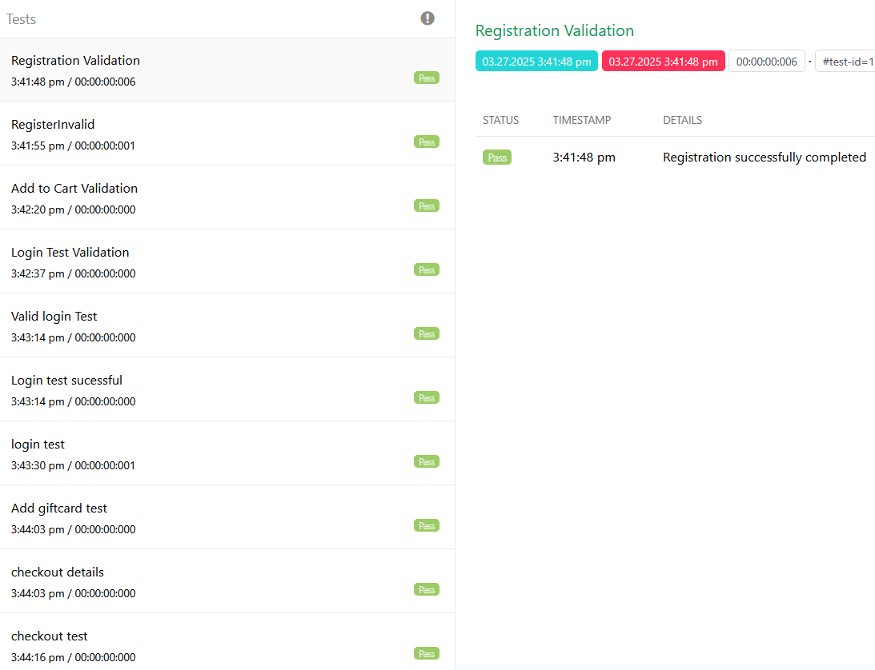
Extent Report: Extent Report are integrated to provide detailed interactive and visually appealed reports.

Slide 14
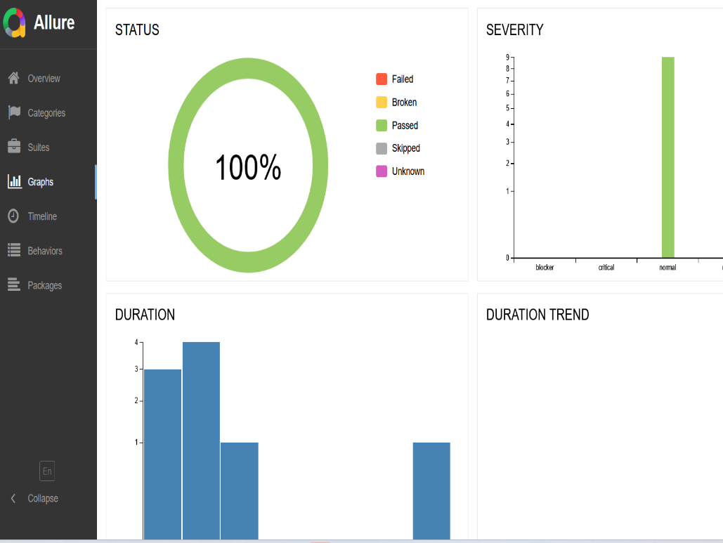
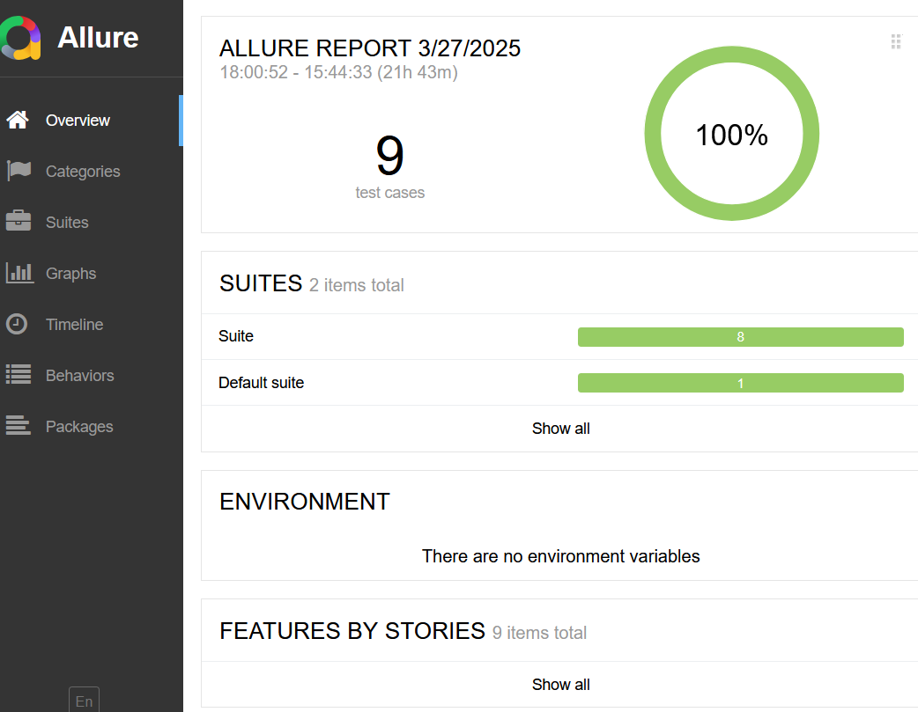
Allure Report: Allure Report is used for generating interactive and visually rich test execution reports with detailed logs, screenshots, and step-by-step execution history.

Slide 15
Conclusion
Capstone Project integrates Java, Selenium WebDriver, TestNG, and Cucumber for structured and efficient test automation.
It follows the Page Object Model (POM) to enhance maintainability, reusability, and scalability.
Key components like feature files, step definitions, and test runners automate functional testing seamlessly.
Extent Reports and screenshots improve test execution transparency and debugging.
The framework enhances test efficiency, reduces redundancy, and ensures high test coverage

